Slide 1

ECEN 461
Real-Time and Embedded Systems
IOT - Information – Fourier Series

Slide 2
Agenda
Prayer/Thought
Cool Technology
Fourier Series
Analysis
Fourier Integral
Synthesis

Slide 3

Cool Technology
http://www.eetimes.com/showArticle.jhtml?articleID=224700658&cid=NL_eet
microrobots

Slide 4
Spectrum Diagram
What sinusoids make up this spectrum?
–21k
–10k
0
10k
21k
f (in Hz)

Slide 5
What is a Harmonic Signal?

Slide 6
DSP Questions
A couple of questions central to DSP
Question 1 – Given an arbitrary signal how can we get its mathematical formula – and hence be able to work with it?
Question 2 – In general, how can we make (or synthesize) any arbitrary signal?

Slide 7
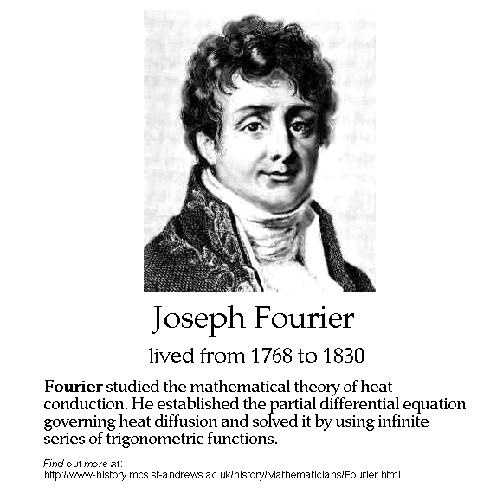
History
Jean Baptiste Joseph Fourier
1807 thesis (memoir)
On the Propagation of Heat in Solid Bodies
http://www-groups.dcs.st-and.ac.uk/~history/Mathematicians/Fourier.html

Slide 8
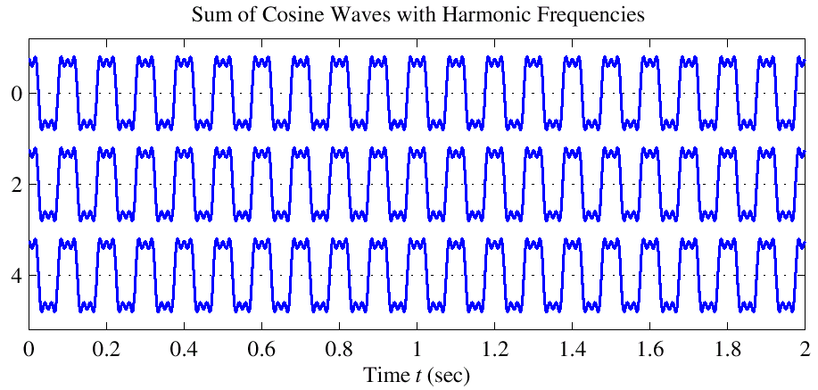
Fourier Series
2 Aspects of Fourier Series
Analysis – starting with x(t), find a mathematical formula for it
This is done by calculating the Fourier coefficients
Synthesis – starting with Fourier coefficients (a_{k}) and generating x(t)

Slide 9
Fourier Series Equations
Fourier Analysis Equations
Fourier Synthesis Equation
These are only valid for periodic signals

Slide 10
Derivation of Fourier Series Integral
Details of the derivation of this integral are in section 3-4.2 of text
Based on Orthogonality Property
Based on Integral of complex exponential over a period = 0
Fourier Series Integral
useful if we have a formula that defines x(t) over 1 period
If x(t) is known only as a recording, then numerical methods (computers) are needed

Slide 11
Square Wave Example
What does the plot of this look like?
x(t)
1
–.02
0
.01
.02
0.04
t

Slide 12
FS for a Square Wave
x(t)
1
–.02
0
.01
.02
0.04
t

Slide 13
DC Coefficient: a₀

Slide 14
Fourier Coefficients a_{k}
a_{k} is a function of k
Complex Amplitude for k-th Harmonic
This one doesn’t depend on the period, T₀

Slide 15
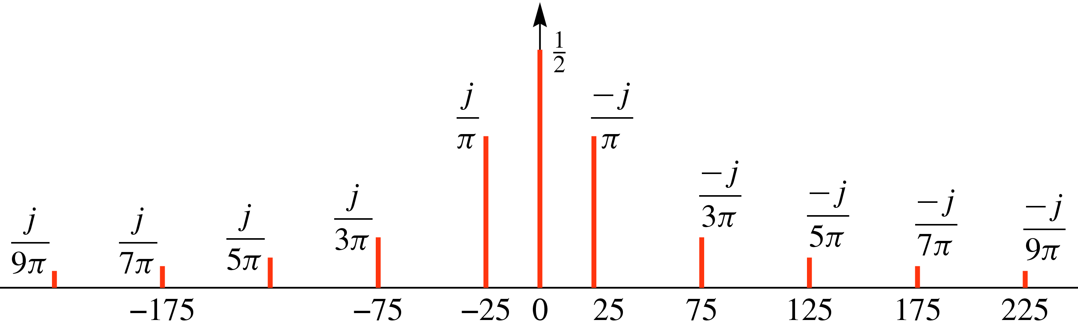
Spectrum from Fourier Series
a_{k} are the complex amplitudes of the freq spectrum !!!
Now, what is the sinusoidal equation for this spectrum?

Slide 16
Fourier Series Synthesis
Question 2 – In general, how can we make (or synthesize) an arbitrary periodic signal from sinusoids?
Fourier Synthesis Equation – How many coefficients are required for this eqn?
Infinite number of coefficients
We need to approximate x(t) by using a finite number of coefficients

Slide 17

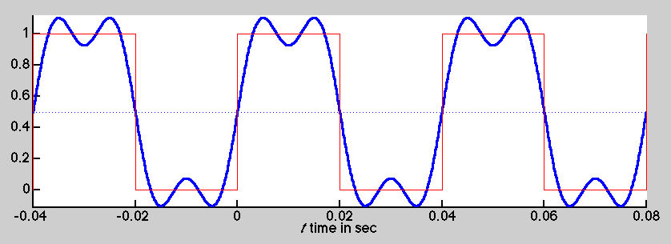
Synthesis: 1st & 3rd Harmonics

Slide 18
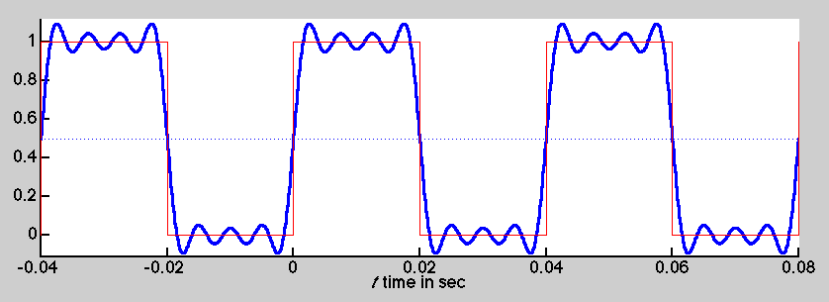
Synthesis: up to 7th Harmonic

Slide 19
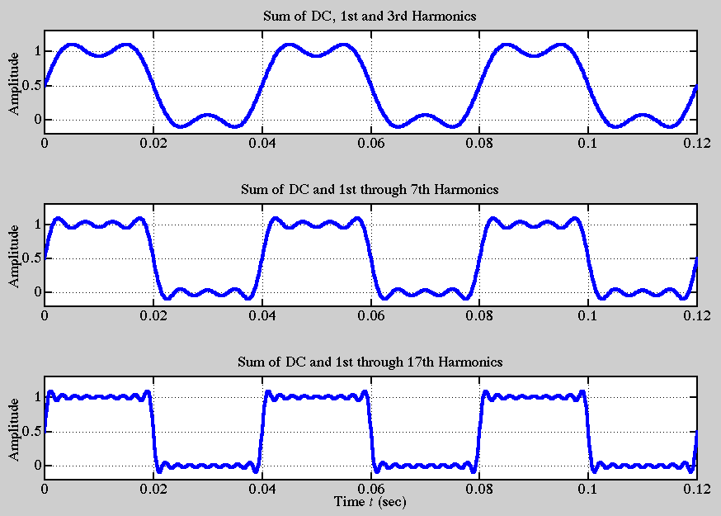
Fourier Synthesis

Slide 20
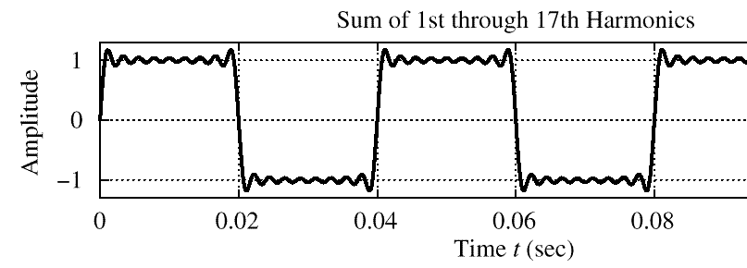
Gibbs’ Phenomenon
Convergence at discontinuity of x(t)
There is always an overshoot
9% for the Square Wave case

Slide 21
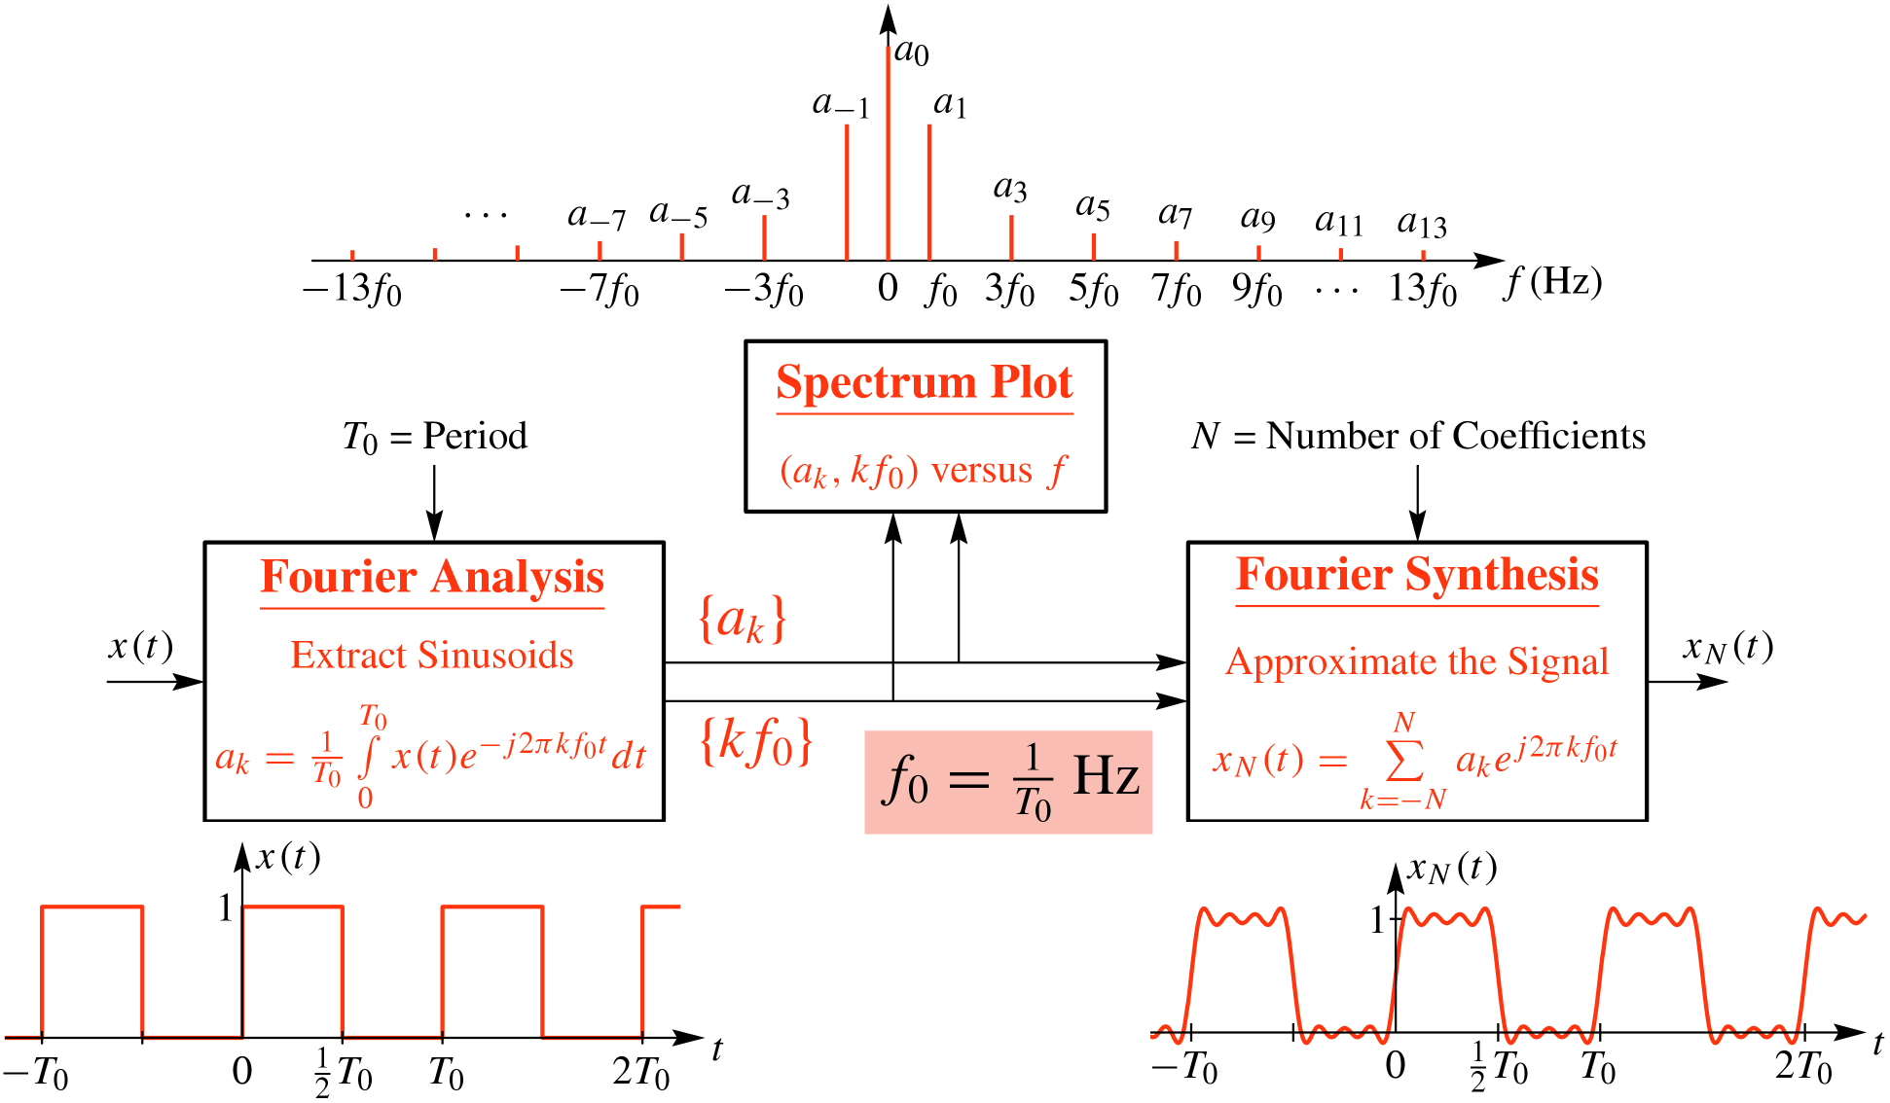
Fourier Series Overview

Slide 22
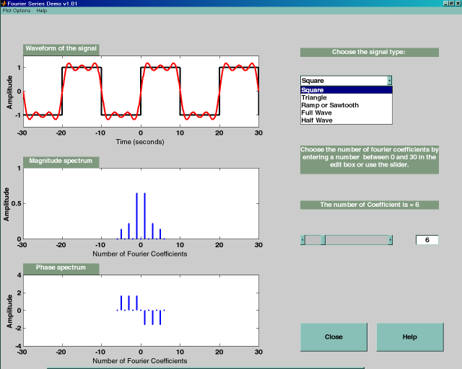
Fourier Series Demos
MATLAB GUI: fseriesdemo
On CD

Slide 23

Another Example: Half-Wave Rectified Sine Wave
Half-Wave Rectified Sine

Slide 24
Half-Wave Rectified Sine Wave Cont

Slide 25
Synthesis vs. Analysis
Analysis
Hard to do by hand
Given x(t), extract (ω_{k},A_{k},φ_{k})
How many freq’s?
Need computer to do this
Synthesis
Can be Easy
Given (ω_{k},A_{k},φ_{k}) create x(t)
Can be Hard
Synthesize Speech so that it sounds good
We will talk next time how to do this on a computer

Slide 26
Backup

Slide 27
Integral Property of exp(j)
Integrate over one period

Slide 28
Orthogonality of exp(j)
Product of exp(+j ) and exp(-j )

Slide 29
Isolate One FS Coefficient

Slide 30
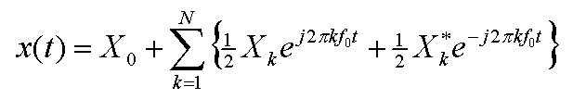
Harmonic Signal – General Form
Where

